Slide 1
Detecting head orientation using neural networks
By: Paul Fitzpatrick
Presented By: Nabeel Alkhatib

Slide 2
What are neural networks
A neural network or more properly referred to as an 'artificial' neural network (ANN) is defined as a computing system made up of a number of simple, highly interconnected processing elements, which process information by their dynamic state response to external inputs. This definition comes from the inventor of one of the first neurocomputers Robert Hecht-Nielsen who defined it as such in an article titled Neural Network Primer: Part I written by Maureen Caudill in 1989.
Another simpler definition of a neural network is that A neural network is a type of machine learning which models itself after the human brain. This creates an artificial neural network that via an algorithm allows the computer to learn by incorporating new data.

Slide 3
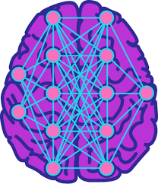
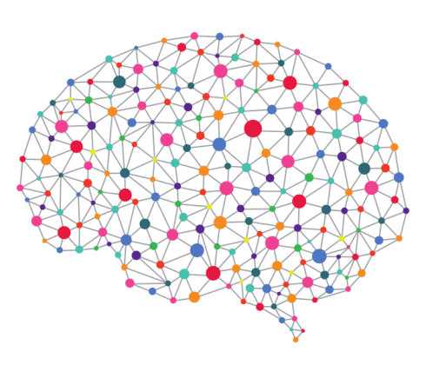
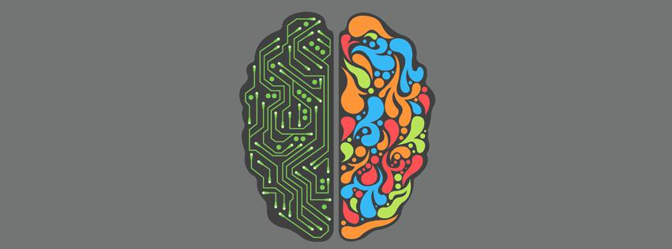
Why were artificial neural networks resemble a human brain
The reason artificial neural networks were based on the human brain is because they exhibit similarities to the human brain such as mimicking the phycology of the human brain and the way the human brain thinks by receiving different kinds of stimulus such as vision or sound and follows a try until you succeed method like we do.

Slide 4
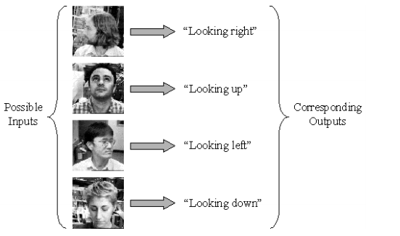
Introduction to Neural Networks
the article is about training a neural network to classify the orientation of a centered image of a head as either up, down, left or right.
this gives information about what someone is paying attention to.

Slide 5
The plan is:
making a classifier that makes decisions that the network desires using motion information. The motion based classifier gathers information on the examples and libels them for training.
From the motion-based classifier, collect training examples.
training neural network to a similar functionality as classifier but without face motion info.

Slide 6
Introduction to Neural Networks
The training process of a neural network is connected to the child development.
Child senses develop as he/she grows older

Slide 7
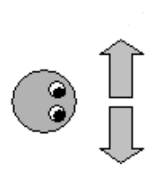
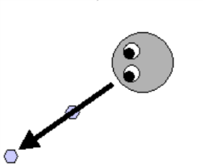
Joint attention
Four stages:
Child notice left and right
Child chooses the first object along gaze direction
Child uses full 3D information to search but he doesn’t look behind him
Child look first behind his head if necessary

Slide 8
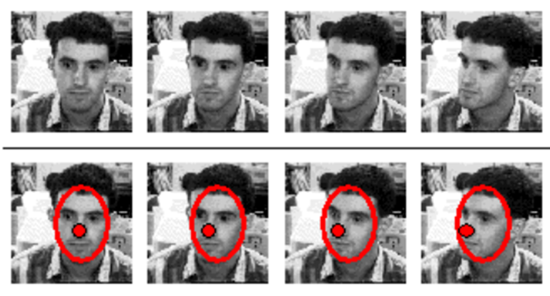
Collecting training data
Data is collected through motion tracking.
A person sits at a fixed distance away from the camera while facing directly at it.
The camera tracks a specific feature on the persons face before moving his/her head in any direction.
The camera then uses motion tracking to track the specific point/feature on the persons face.

Slide 9
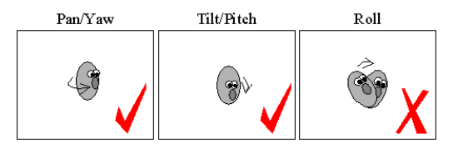
Data collection
A persons neck has 3 degrees of freedom called the pitch, yaw and roll.
The author decided to only consider two of them the yaw and the pitch.
The reason for this is because it is harder to measure the change in feature on the face because the head outline moves a lot than the feature.

Slide 10
Tracking head features
The motion-based head orientation classifier was created by modifying an object tracker and it was designed to keep the camera focused on the moving target. The tracker receives information at 30 frames a second.
The standard for the simplest tracking technique is to chose a small patch at the center of the image and then look for the same patch in the next image that best matches the original image.
How good a match is, is measured by the Euclidean distance which is the straight line distance between both the original point and the next patch point.

Slide 11
Different ways to track the head
The author tried using three different ways to differentiate the head movements from the head rotations.
Image differencing: successive frames can be subtracted from each other to detect areas of motion.
Face detection: using an already made face detector program; but unfortunately it is not designed to work with non-frontal views of the face.
Tracking ovals: The outline of the moving face can be approximated as a deforming oval for tracking.

Slide 12
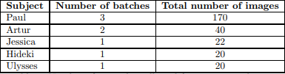
Faces collected
The amount of faces the author collected for this experiment was 270 all spread out among different people on a table although one participant named Paul had the most photos of him taken.

Slide 13
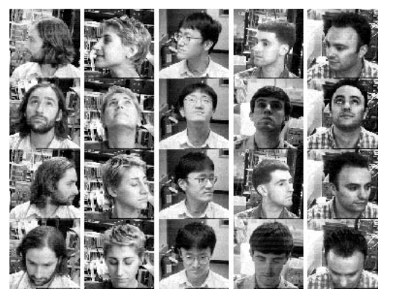
Light was fixed background was changed between different batches

Slide 14
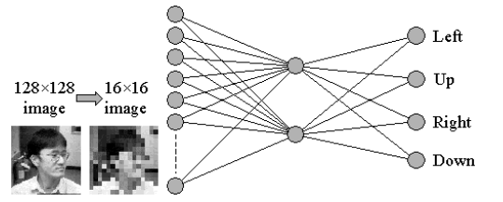
Network architecture
The neural network architecture is as follows:
Notes:
16*16 = 256 neurons in the input layer

Slide 15
Network architecture
The author chose two neurons in the hidden layer to force the neural network to chose between the four neurons in the output layer to differentiate between the four directions of up, down, left and right through a two-dimensional representation.
the output that was desired by the networks was set to have a 1 at the output neuron which corresponds to the direction of the gaze and 0 at the other neurons.

Slide 16
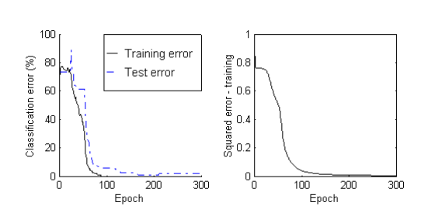
backpropagation
The classification error on the training set quickly falls to zero and even the error on the test set continues to fall.

Slide 17
Results of the classification
This is the matrix result for a subject named Hideki when the neural network was trained to on subjects Paul, Artur and Jessica.
Hideki wore glasses which was quiet different from all of the other subjects but despite that the neuron network managed to correctly classify 20 head pose pictures that were taken of him.

Slide 18
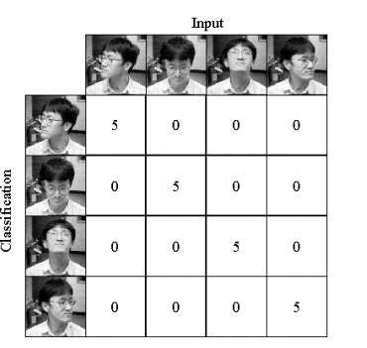

Slide 19
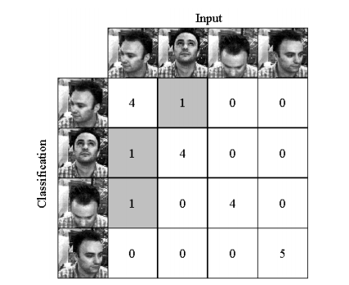
Results of the classification
The results for subject named Ulysses are quiet different even though the training of the neural network was similar to Hideki the neural network makes 3 classification errors and on a total of 20 inputs.

Slide 20
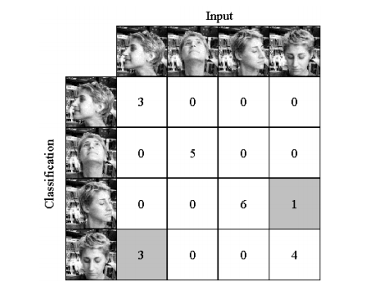
Results of the classification
As for Jessica the neural network was trained on only Paul and Artur and makes 4 classification errors on the total of 22 inputs. The neural networks tends to confuse right with down a lot. The reason for this is because Jessica has a fair amount of hair unlike than either Paul or Artur.

Slide 21
Conclusion
The author presented a very simple neural network architecture in the paper. Even though he ended up trying multiple different architectures, and various forms of feature selection on the input but none of them gave him the results that he wanted so he had to stick with the two hidden neuron architecture as it gave him the results that he was looking for and it was easier to explain than the other types of architectures that he had used.

Slide 22
References
https://www.marshall.usc.edu/blog/how-do-neural-networks-mimic-human-brain
https://medium.com/predict/artificial-neural-networks-mapping-the-human-brain-2e0bd4a93160
http://pages.cs.wisc.edu/~bolo/shipyard/neural/local.html
https://www.techradar.com/news/what-is-a-neural-network

